Slide 1
UNIT 9
Network Architecture and Components

Slide 2
IPs

Slide 3
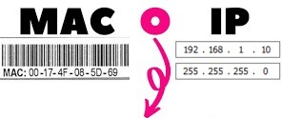
MAC vs IP
MAC adresses or physical adresses allow data movement inside the same network.
However, MAC adresses do not give any info about where each device is, so they are useless to communicate among different networks.
To do so, we'll use IP adresses or logical adresses which indicate in which network is each device. That way routers are able to route network packages from the origin network to the destination network.

Slide 4
IP addresses format
IPV4 general format
IP adresses are composed by 32 bits grouped in 1 byte blocks (or 8 bits)
An IP example:
1 byte = 8 bits | 1 byte | 1 byte | 1 byte
11000000 | 00000111 | 00100010 | 00001010
192 | 7 | 34 | 10
To be human friendlier, IP adresses usually are expressed as decimal numbers separated by dots:
Decimal IP: 192.7.34.10
Converting an 8 bits number from binary to decimal...
𝟐^{𝟕}=128 | 𝟐^{𝟔}=64 | 𝟐^{𝟓}=32 | 𝟐^{𝟒}=16 | 𝟐^{𝟑}=8 | 𝟐^{𝟐}=4 | 𝟐^{𝟏}=2 | 𝟐^{𝟎}=1
1 | 1 | 0 | 0 | 0 | 0 | 0 | 0
=128+64=192

Slide 5
IP addresses format
Maximum and minimum values for each byte of the IP address
To get the minimum value for an IP we set each bit to 0:
00000000
𝟐^{𝟕}=128 | 𝟐^{𝟔}=64 | 𝟐^{𝟓}=32 | 𝟐^{𝟒}=16 | 𝟐^{𝟑}=8 | 𝟐^{𝟐}=4 | 𝟐^{𝟏}=2 | 𝟐^{𝟎}=1
0 | 0 | 0 | 0 | 0 | 0 | 0 | 0
=0
To get the maximum value, we set all bits to 1:
11111111
𝟐^{𝟕}=128 | 𝟐^{𝟔}=64 | 𝟐^{𝟓}=32 | 𝟐^{𝟒}=16 | 𝟐^{𝟑}=8 | 𝟐^{𝟐}=4 | 𝟐^{𝟏}=2 | 𝟐^{𝟎}=1
1 | 1 | 1 | 1 | 1 | 1 | 1 | 1
=128+64+32+16+8+4+2+1=255
Valid IP address?
192.7.126.11
192.168.257.34
yes
no

Slide 6
IP addresses format
Network section and host section
IP addresses have two parts
First section identifies the network where the device is
Second section identifies the device or host
Depending on the network, a number of bits is used to identify the network (8, 16, 20...) and the rest for the host. Example:
1 byte = 8 bits | 1 byte | 1 byte | 1 byte
11000000 | 00000111 | 00100010 | 00001010
Parte red: 16 bits Parte host: 16 bits
The network mask is a sequence of 32 bits that allows to identify which part of the address identifies the network and which part identifies the host. Is obtained by setting 1s to the bits of the network and 0s to the host part. As an example:
11111111 11111111 00000000 00000000

Slide 7
IP addresses format
IPv4 Format Summary
32 bits
IP Address
Network part n bits
Host part 32-n bits
Maximum number of networks that we can create using n bits for the network part:
₂𝑛
Maximum number of IP addresses that we can create inside each network:
₂32-n ₋₂

Slide 8
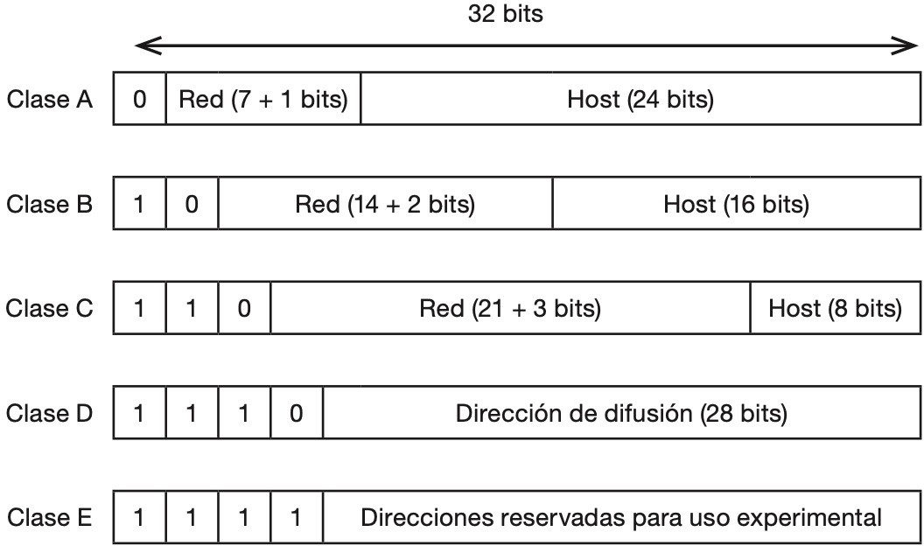
IP addresses format – Classes
There are 5 classes and just by looking at the first bits of an IPv4 address we can figure out which class is that address
Only A, B and C classes are useful for the regular network usage

Slide 9
IP addresses – Network Address
The network address is an IP address that identifies a whole network.
It's used to rout packages so they reach the hosts of that network.
To calculate it the bits assigned to the host address must be set to 0. That's because the network address does not identify any host on the network.
An example:
1 byte = 8 bits | 1 byte | 1 byte | 1 byte
11000000 | 00000111 | 00000000 | 00000000
Network section: 16 bits Host section: 16 bits
Network ip address of the example: 128.7.0.0

Slide 10
IP addresses – Broadcast Address
The broadcast address is used by devices that want to send a datagram that is meant to be seen by any device in the same network
To calculate the default broadcast address the host bits must be set to 1. Take into account that the broadcast address can also be configured.
Example:
1 byte = 8 bits | 1 byte | 1 byte | 1 byte
10000000 | 00000111 | 11111111 | 11111111
Network section: 16 bits Host section: 16 bits
Broadcast address for that example: 128.7.255.255

Slide 11
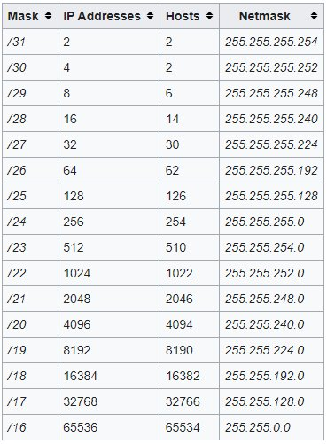
IP addresses – Subnet mask
The subnet mask is a sequence of 32 bits that it's to distinguish which part codifies the network and which one the host.
To get it, you have to set the network section bits to 1s and the host section to 0s
Subnet mask:
11111111 1111111100000000 00000000
/16
255.255.0.0

Slide 12
IP addresses – Subnetting
If a network grows too much and there are too many devices it should be divided because:
The broadcast domains get smaller
As the networks gets smaller is easier to manage
The easiest way to do it is to divide a network in subnets that have the same size. However, as the IPs quantity is limited and there are more and more devices that need connectivity usually each subnet has a different size, adapted to the number of devices it needs to manage.

Slide 13
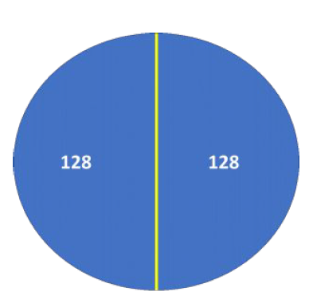
IP addresses – Subnetting
Having this network:
192.168.0.0/24
We calculate hoy many IPs are available, including the network and broadcast address: C Class= 256
We choose hoy many subnets we'll divide it, in this example 2 subnets each one with 128 hosts
SUBNET 1:
Network address: 192.168.0.0
Mask: 256-128 = 128
255.255.255.128 = /25
First host: 192.168.0.1
Last host: 192.168.0.126
Broadcast: 192.168.0.127
SUBRED 2:
Network address: 192.168.0.128
Mask: 256-128 = 128
255.255.255.128 = /25
First host: 192.168.0.129
Last host: 192.168.0.254
Broadcast: 192.168.0.255

Slide 14
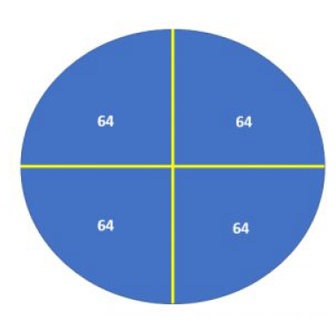
IP addresses – Subnetting
The same network but in 4 subnets with 64 hosts each one:
SUBNET 1:
Network address: 192.168.0.0
First host: 192.168.0.1
Last host: 192.168.0.62
Broadcast: 192.168.0.63
SUBRED 2:
Network address: 192.168.0.64
First host: 192.168.0.65
Last host: 192.168.0.126
Broadcast: 192.168.0.127
SUBRED 3:
Network address: 192.168.0.128
First host: 192.168.0.129
Last host: 192.168.0.190
Broadcast: 192.168.0.191
SUBRED 4:
Network address: 192.168.0.192
First host: 192.168.0.193
Last host: 192.168.0.254
Broadcast: 192.168.0.255
Máscara para las 4 subredes:
256 – 64 = 192
255.255.255.192
/26

